Slide 1
Module 5

Slide 2

Growth independent :
Certain movements of plants that do not result in their growth are termed as growth independent movement.
When we touch the leaves of mimosa pudica plant the leaflets close
Touch me not
Can you see any growth?
Can you see any movement?
NO !
YES !
So this is a perfect example of growth independent movement.
In this, the movement is in response to the stimulus of touch.
This movement is called as
“SEISMOSNASTIC MOVEMENT”.

Slide 3

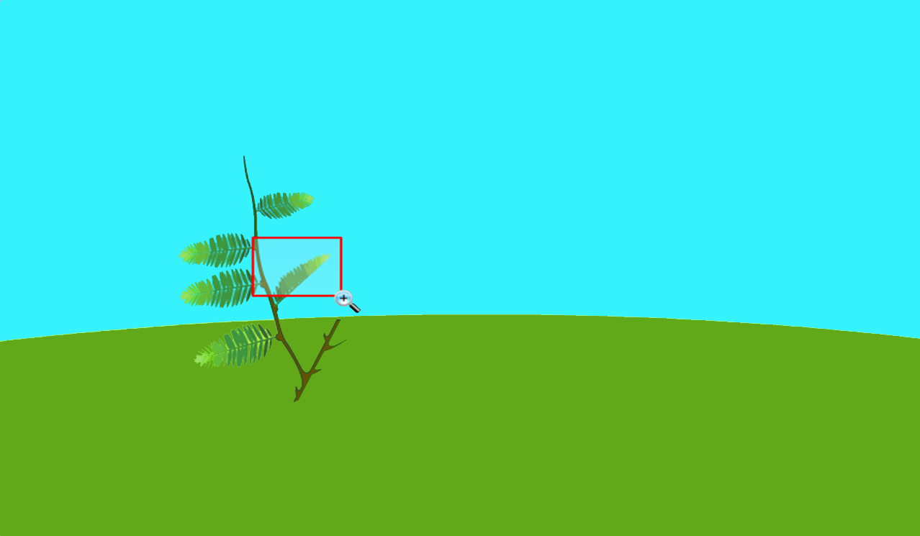
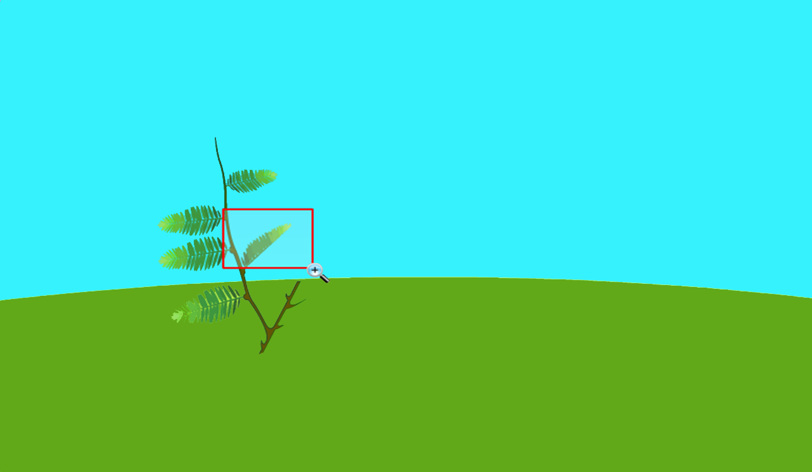
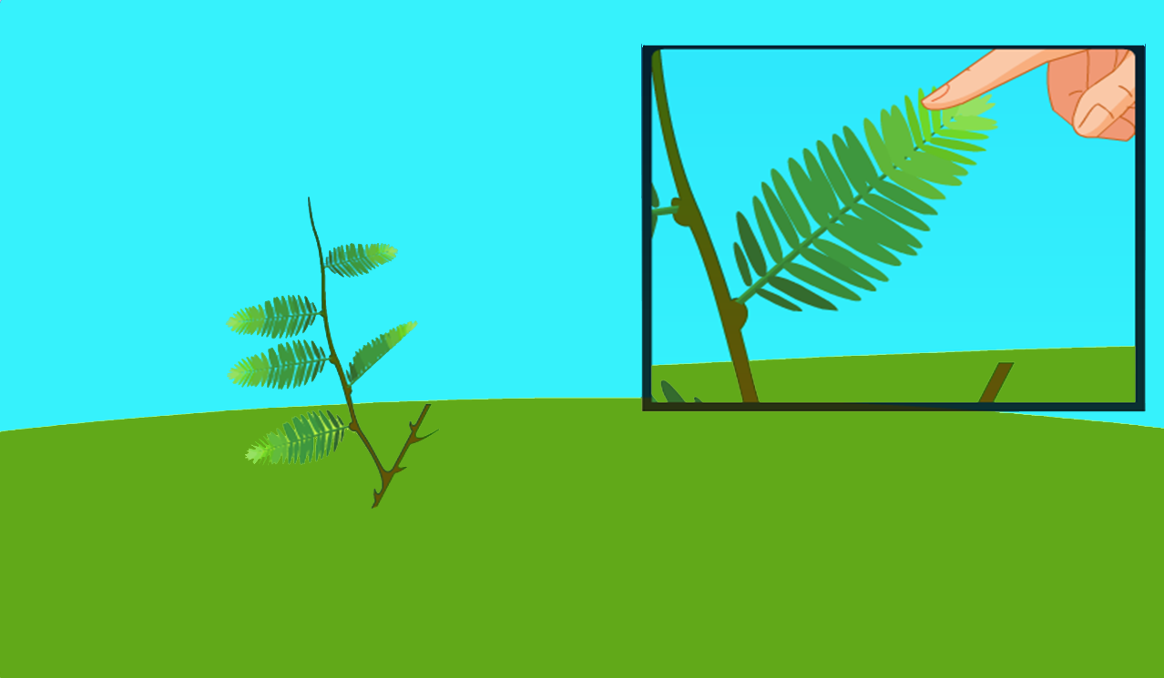
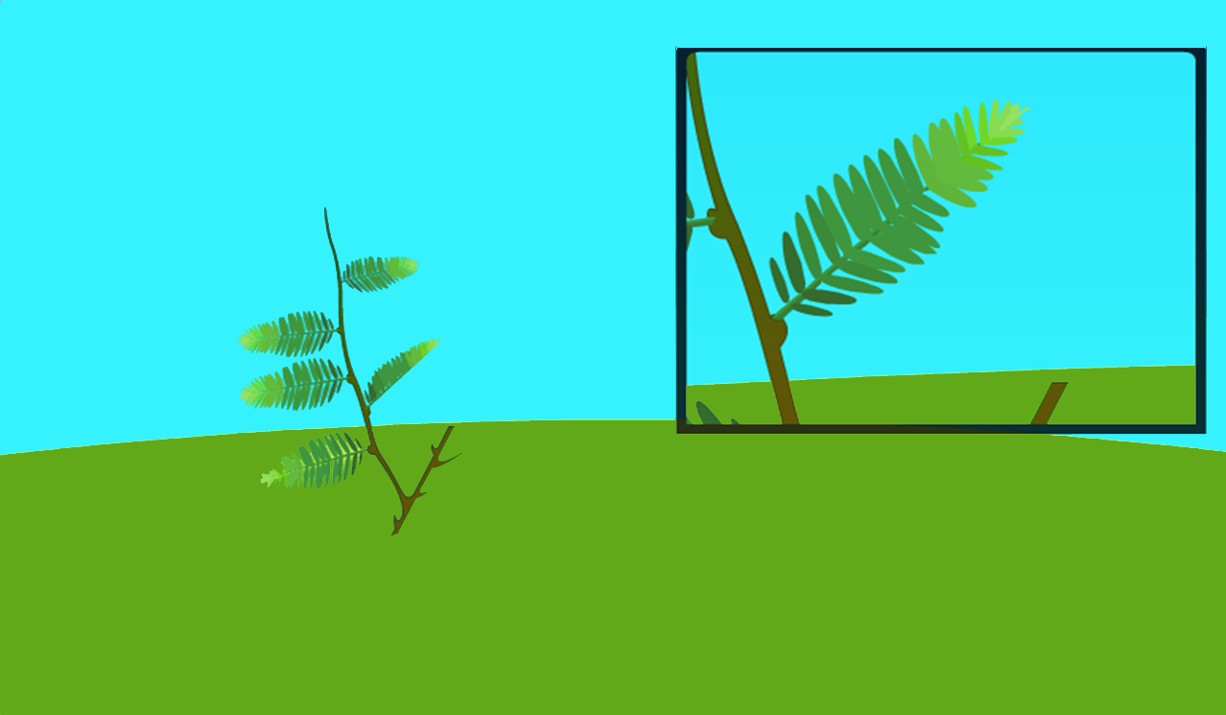
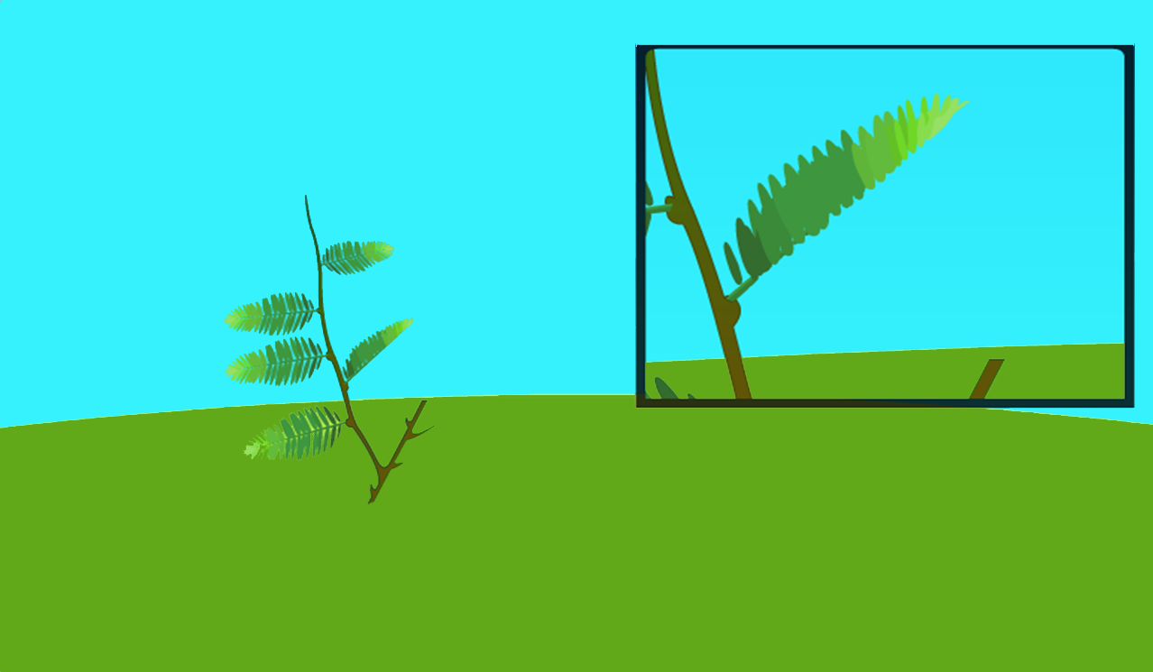

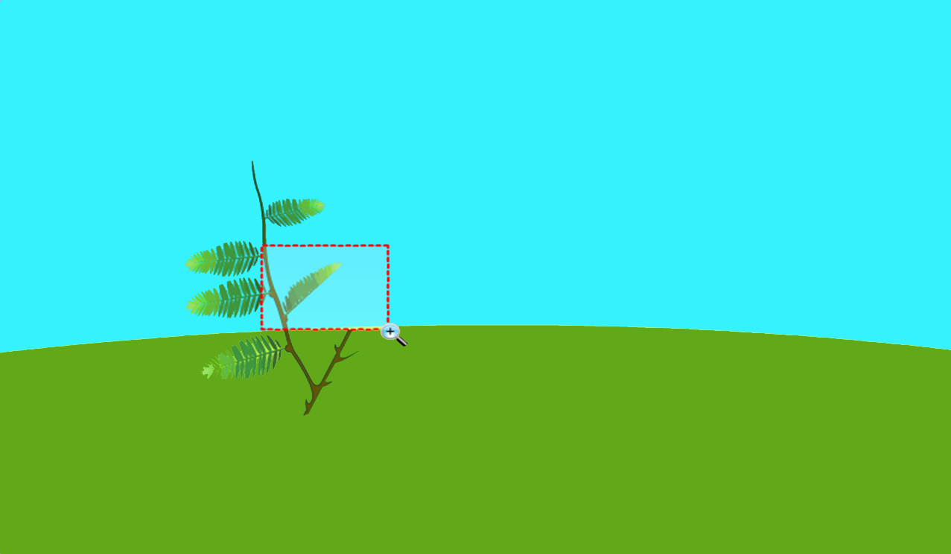
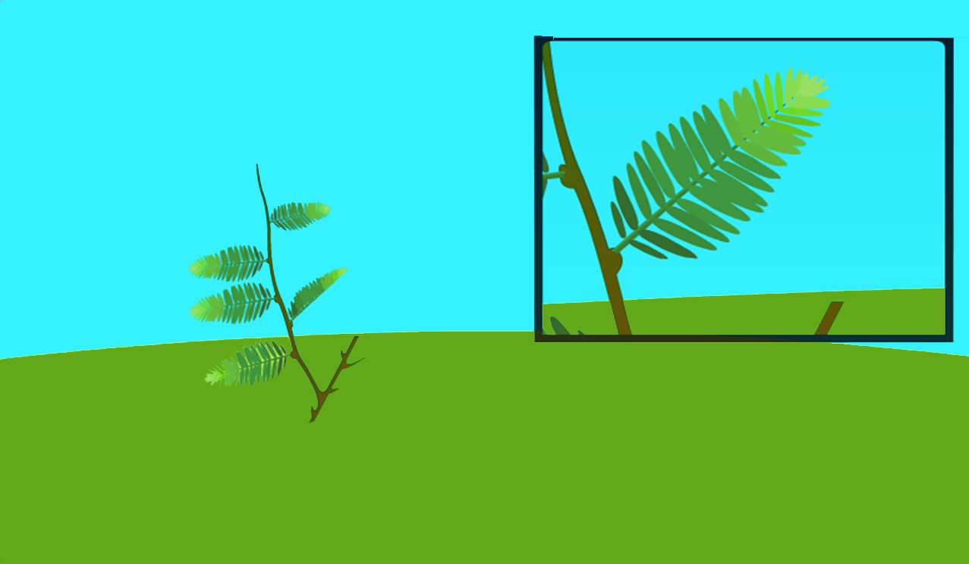

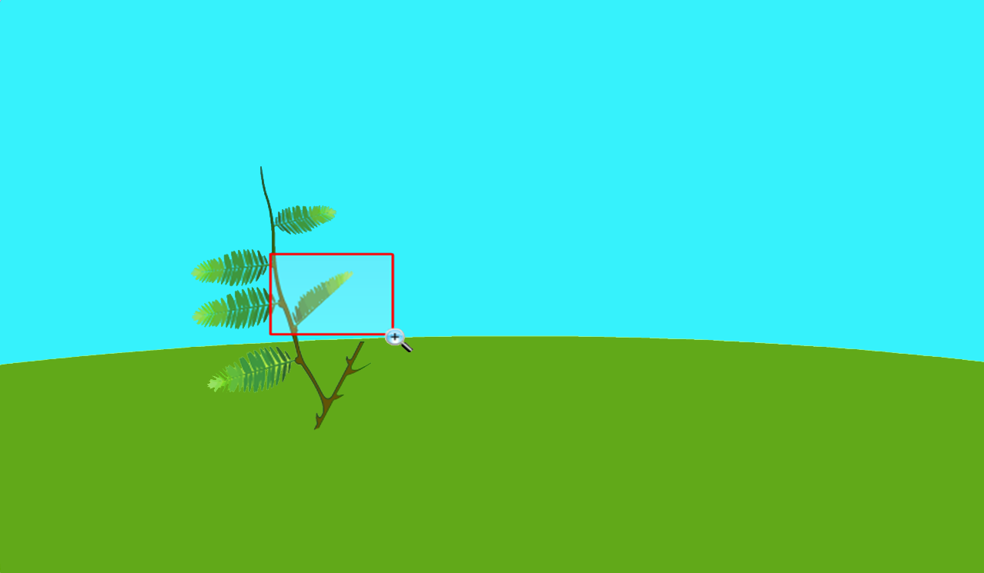
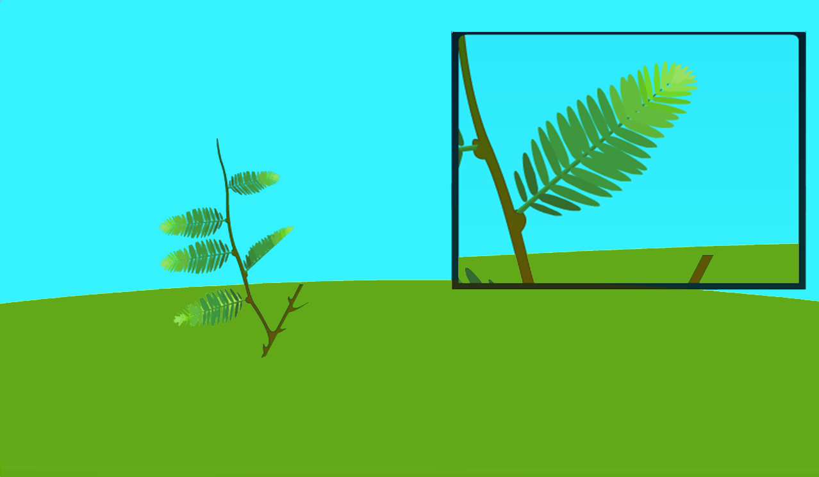


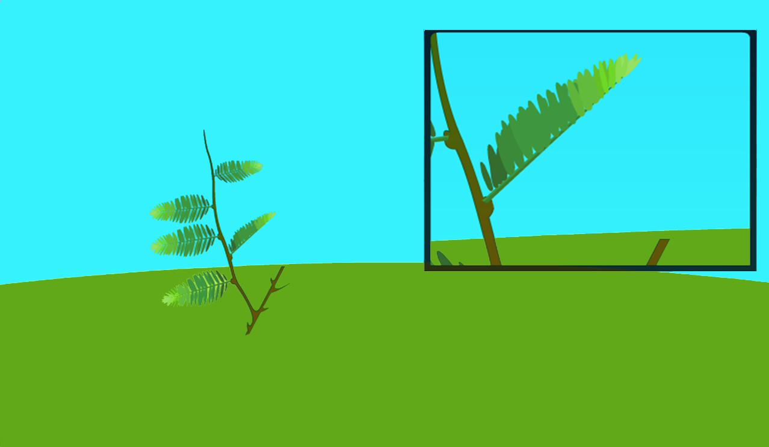
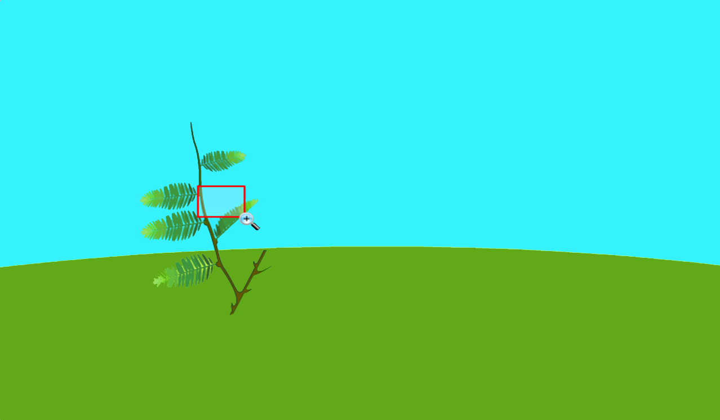
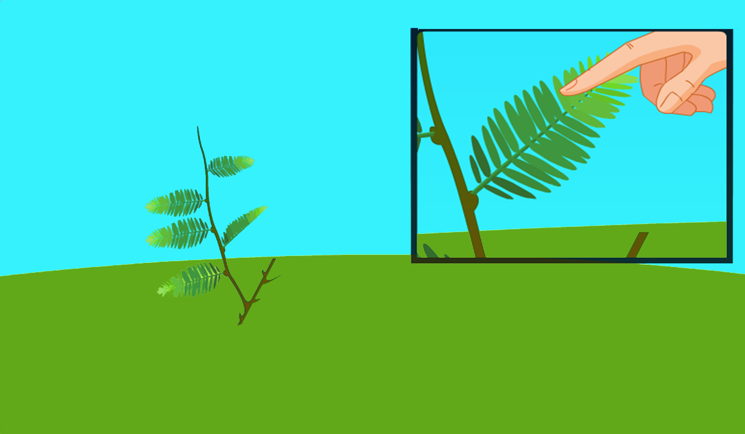
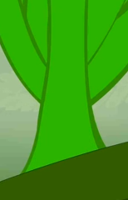
Growth independent :
Let us see how does this happen…..
Hormones are released
K +
K +
K +
K +
K +
K +
These hormones along with some ions move from one cell to another passing the information.
Ions cause the water to come out from the cells.
As we know, movement in plants are brought about by hormones in response to the changes occurring in its surrounding.
The change in the shape of the cells causes the movement in plant.
But since the information is conducted from one cell to another the movement also happens at a place different from touch.
When we touch the leaves of mimosa pudica plant the hormones are released.
Leading the cells to shrink.

Slide 4
So what do we know about growth independent movement ?
Ions – Charged elements
Hormones
The movement occurs at a place different from the place of touch.
This means that the information has been communicated.
The plant use electrical and chemical means to transfer the information from one cell to another.
There is no specialized tissue present for conduction of information.
The cells either swell or shrink and thus change their shape to cause movement in plant.

Slide 5
Thank You

